Slide 1
LECTURE -03
Descriptive Statistics Part (a)
Course Intructor
Engr. NainaSaid

Slide 2
Descriptive Statistics
CSE-422: DataAnalytics
A method used to describe and understand the features of data set by giving short summaries about the data.
Gives us the overall picture of the data.
Answers the following questions
What is the value that best describes the dataset?
How much a data set spreads from its average value?
What is the smallest and largest number in a dataset?

Slide 3
Categories Descriptive Statistics
CSE-422: DataAnalytics
Divided into three sub-categories
Measure of Central Tendency(Mean,Median,Mode)
Measure of Variability/Spread ( Range, variance, standard deviation,skewness)
Measure of relationship between variables (covariance and correlation)
Descriptive statistics do not, however, allow us to make conclusions beyond
the data we have analyzed.

Slide 4
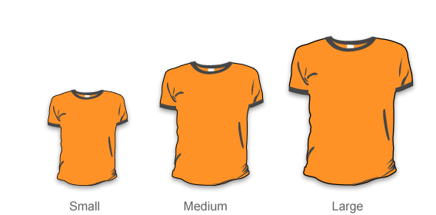

Slide 5
Measures of Central Tendency

Slide 6

Measure of Central Tendency
CSE-422: DataAnalytics
Spoiler Alert : These will be used in data cleaning/ datapre-
processing part of machine learning. So take notes!

Slide 7
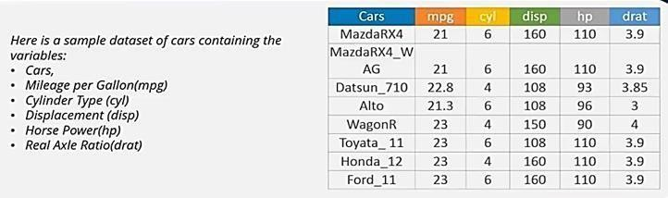
Mean
CSE-422: DataAnalytics
Mean Horse power= 110+110+93+96+90+110+110+110/8= 103.625
It is affected by extreme values (outliers). Very large or very small numbers can distort the answer

Slide 8
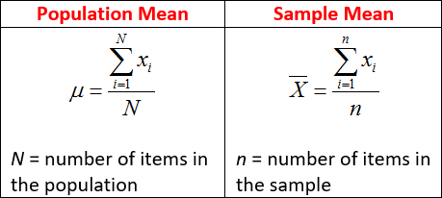
Population and Sample Mean
CSE-422: DataAnalytics

Slide 9
Median
CSE-422: DataAnalytics
It is the middle value. To find out the center value of mpg for the population of cars, arrange all the values in ascending order. 21,21,21.3,22.8,23,23,23,23. In case of even values, take the average of the middle two values. (22.8+23)/2 = 22.9
It is NOT affected by extreme values. Very large or very small numbers do not
affect it

Slide 10
Getting affected by Extreme Values???
CSE-422: DataAnalytics
The advantage of the median over the mean is that mean is sensitive to outliers. So, in situations where there is a high chance that there may be outliers present in the data set, it is wiser to take the median instead of the mean. For example, to understand what is the per capita income of a country, the median is taken because the rich may be extremely rich which would skew the average and show a different picture than what the average people might experience. In that case, taking the median would give a better insight.

Slide 11
Mode
CSE-422: DataAnalytics
It is the value that occurs most frequently in a dataset e.g. cylinder type6.
It can be used when the data is not numerical.
There may be no mode at all if none of the data is the same.
There may be more than one mode.

Slide 12
Example
CSE-422: DataAnalytics
Suppose a company is considering expanding into an area and is studying the size of containers that sells the most. Which measure do you think they should use?

Slide 13
When to Use Mean, Median and Mode
CSE-422: DataAnalytics
Mean – When your data is not skewed i.e. normally distributed. In other words, there are no extreme values present in the data set(Outliers)
Median – When your data is skewed or you are dealing with ordinal (ordered
categories) data (e.g. scale 1. Strongly dislike 2. Dislike 3.Neutral
Strongly like)
Mode - When dealing with nominal (unordered categories) data.
4. Like 5.

Slide 14
Measures of Variability/Spread

Slide 15
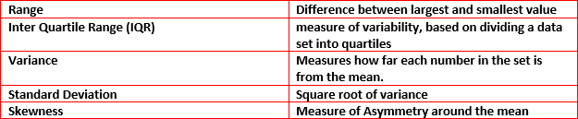
Measure of Variability/Spread
CSE-422: DataAnalytics

Slide 16
Range
CSE-422: DataAnalytics
Represents the difference between the low and high value in data.
Calculation: R = High – Low
Example: In {4, 6, 9, 3, 7} the lowest value is 3, and the highest is 9.
So the range is 9 − 3 = 6.

Slide 17
Range Can be Misleading
CSE-422: DataAnalytics
The range can sometimes be misleading when there are extremely high orlow values. (Outliers)
Example: In {8, 11, 5, 9, 7, 6, 3616}: the lowest value is 5,
and the highest is 3616.
So the range is 3616 − 5 = 3611.
The single value of 3616 makes the range large, but most values are around 10.
We can use interquartile range instead.

Slide 18
Variance
CSE-422: DataAnalytics
It measures how far a set of numbers is spread out from their average value.
N
∑
( x − μ)
2
_{σ} 2
i
₌ i=1
N
Where is the population variance
μ is the population mean
N is the total number of values in thepopulation
x
is the value of the i-th observation.
i
Why is it squared? We will take care of it when talking about standard deviation.

Slide 19
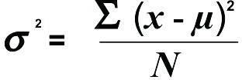
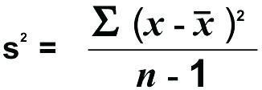
Sample Vs Population Variance
CSE-422: DataAnalytics
Sample variance is divided by “n-1”.
Why? (something to do with the concept “degrees of freedom)
Population Variance
Sample Variance

Slide 20
Sample Vs Population Variance Continued..
CSE-422: DataAnalytics
When to use what?
We are normally interested in knowing the population variance because
our population contains all the values we are interestedin.
You use the population variance formula when
You have the entire population or
You have a sample of a larger population, but you are only interested in this
sample and do not wish to generalize your findings to the population.
if all you have is a sample, but you wish to make a statement about the population variance from which the sample is drawn, you need to use the sample variance formula.

Slide 21
Examples
CSE-422: DataAnalytics
A teacher sets an exam for their pupils. The teacher wants to summarize the results the pupils attained as a mean and variance. Which variance should be
used?
Population Variance
A researcher has recruited males aged 45 to 65 years old for an exercise training study to investigate risk markers for heart disease (e.g., cholesterol). Which variance would most likely be used? Sample Variance

Slide 22
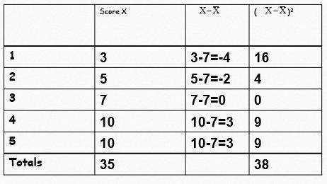
CSE-422: DataAnalytics
Calculating Variance
= ³⁸ = 7.6
5

Slide 23
Real Life Uses of Variance
CSE-422: DataAnalytics
Example 1: Stock market or other investment returns. The stock market has return on average 7% per year. This does not mean that every year you get a 7% return, some years are more and some years are less. This variability (called volatility in stock terms) is an example of variance.
Example 2: You drive to work every day and take the same route. There is both variation in the time it takes you to get to work and variation in the amount of gas you use (due to factors like traffic, stop light timing etc.) All of this variability can be measured with variance.

Slide 24
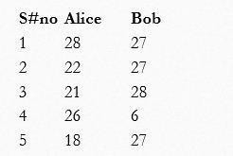
Task
CSE-422: DataAnalytics
Consider the driving speeds of Alice and Bob recorded for 5 days in the table below
Calculate the mean, median, mode andrange.
What can be said about thisdata?
Which driver has been moreconsistent?

Slide 25
Variance and Reliability of Data Summary
CSE-422: DataAnalytics
Remember ! When variability of a dataset increases, the summary of the data becomes less reliable.
Example : Two basket ball players have the same mean of 15 points per game. Player 1 always scores between 13 and 17 points per match while player 2 scores anywhere between from 5 to 25 points pergame.
Would you be more confident predicting the number of points in the next game for player 1 or player 2?

Slide 26
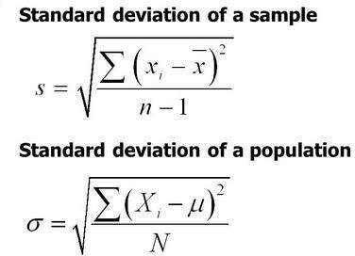
Standard Deviation
CSE-422: DataAnalytics
In order to get rid of the “square” (which does not make any sense) variance, we take a square root of the variance.
T ells us the same thing as variance.
in the

